Slide 1
RNN & LSTM in DETAIL
Arunabh Singh LHL Jan 2021

Slide 2
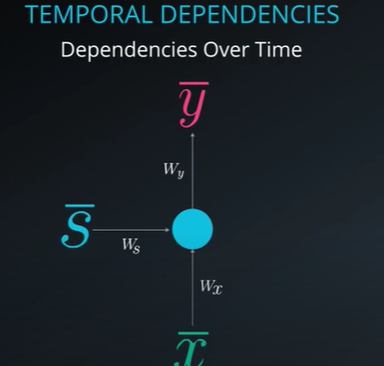
Temporal Dependence
Temporal Dependencies mean output depends on previous inputs
Example of this is predicting next word in a sentence
RNN uses memory to store this information and learn each input connection with previous inputs
Memory is defined as the output of hidden layer neurons, which will serve as additional input to the network during next training step.
Source: Udacity

Slide 3
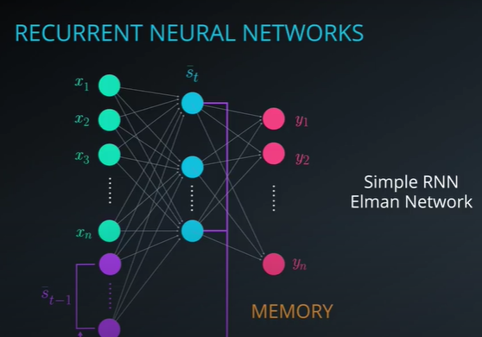
Difference between RNN and Feed Forward NN
FFNN uses hidden layer to feed forward to output layer.
Whereas an RNN uses a hidden layer to give a feedback
The hidden states go as inputs to next time step.
Thus we mimic a temporal dependence or a sequence where the current element in sequence is based on previous elements.
Source: Udacity

Slide 4
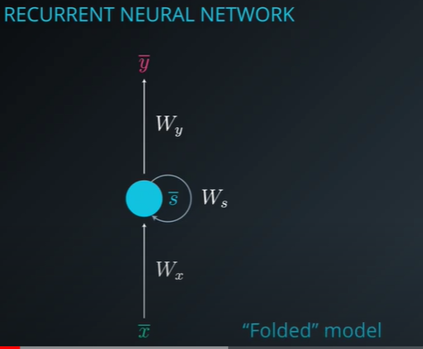
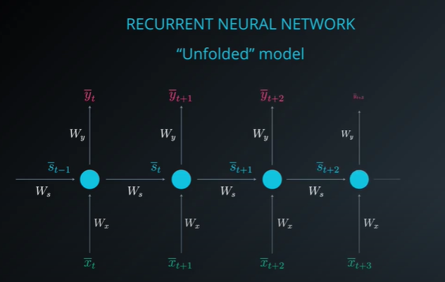
Unfolded RNN
At every time step RNN looks the same this is known as the folded model.
Unfolded representation is where we display every time step of the model as the right image below.
Source: Udacity

Slide 5
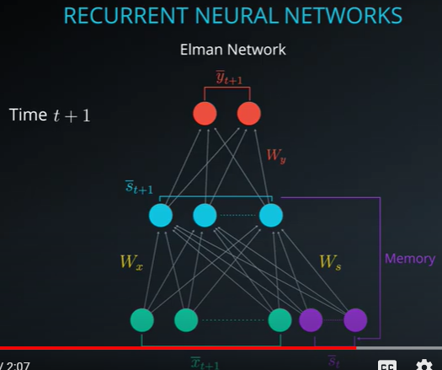
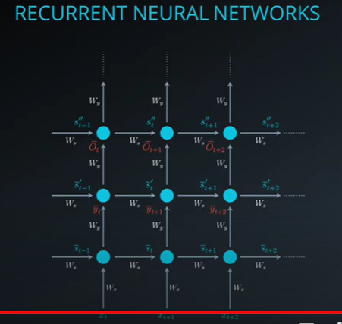
Typical Neural network vs unfolded NN representation
As you can see below this representation is much cleaner. On the left we have the regular representation and unfolded one on the right
Source: Udacity

Slide 6

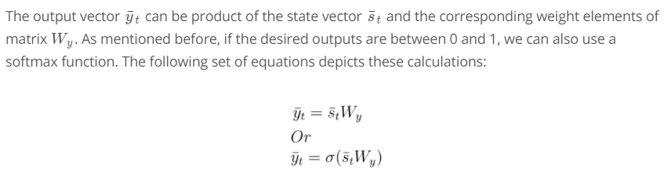
BPTT in RNN
Back Propagation through time is the technique used by RNNs to adjust weights while training.
State Vector St is calculated as
As we can St depends on current input xt and St-1 or previous state.
An RNN is a sequence of these St calculation for N steps in addition to regular activation function and input.
Source: Udacity

Slide 7
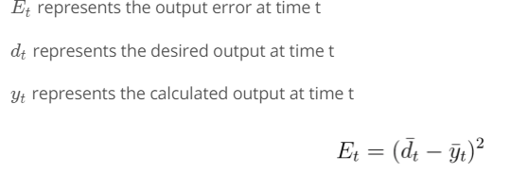
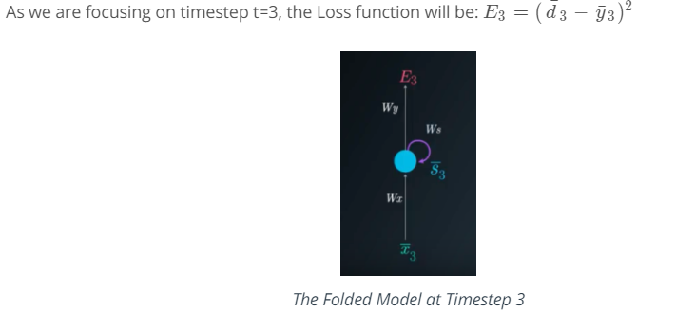
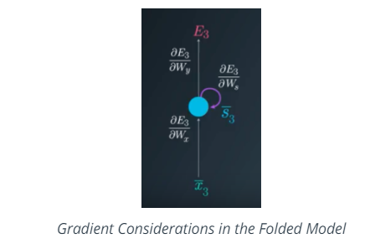
BPTT in RNN (continued..)
Error Calculation is done at each time step.
Error Calculation is done at each time step.
Source: Udacity

Slide 8
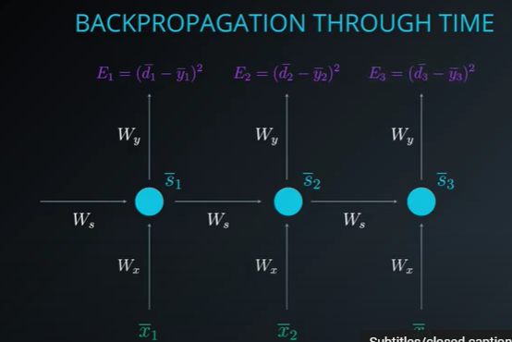
BPTT in action
There are 2 weight matrices to be adjusted using back propagation through time.
Wx is the first matrix to be adjusted which connects hidden layer(state) to input.
Ws is the second one which is weights between hidden layer and hidden layer.
Source: Udacity

Slide 9
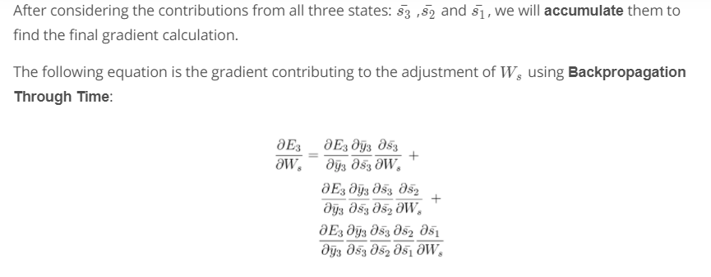
Updating Ws
In general, there can be N time steps and Output at a time step will involve calculating Error from output w.r.t to each state from previous time step.
Thus these previous states can have correct weights in the weight matrix Ws and eventually the model predicts correctly.
Source: Udacity

Slide 10
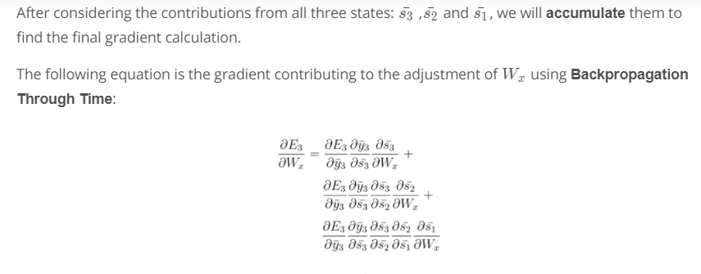
Updating Wx
In general, there can be N time steps and Output at a time step will involve calculating Error from output w.r.t to each state from previous time step.
All the states will have a weight that is impacted by input they receive. Thus these weights can be updated correctly to get required states.
Source: Udacity

Slide 11
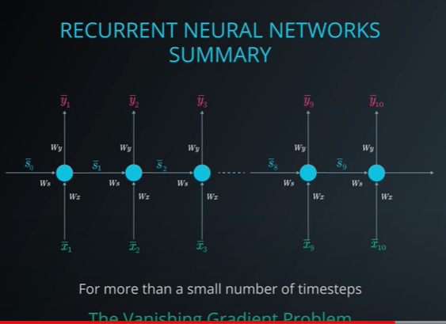
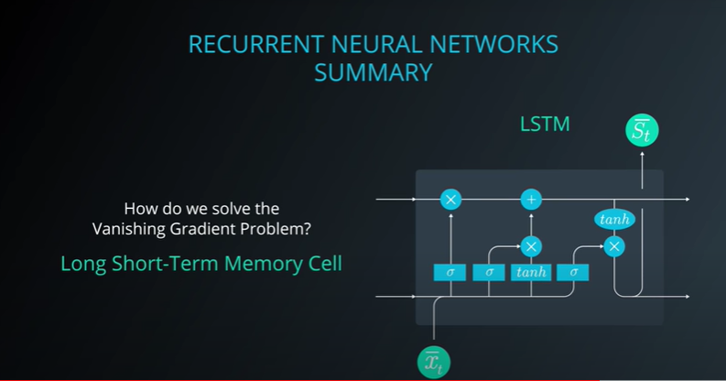
The Vanishing Gradient Problem
Source: Udacity

Slide 12
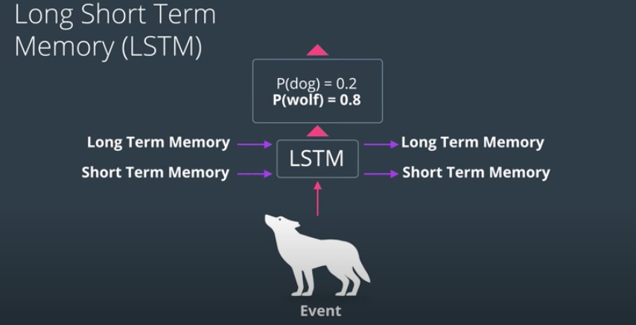
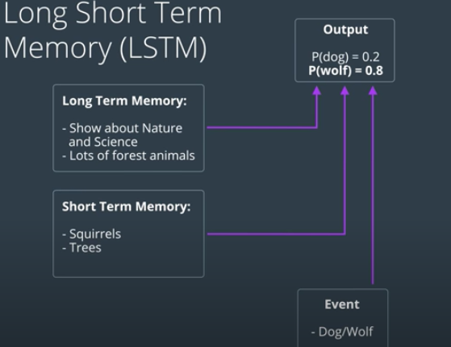
LSTM
LSTM uses both long and short term memory to predict next item in a sequence.
Source: Udacity

Slide 13
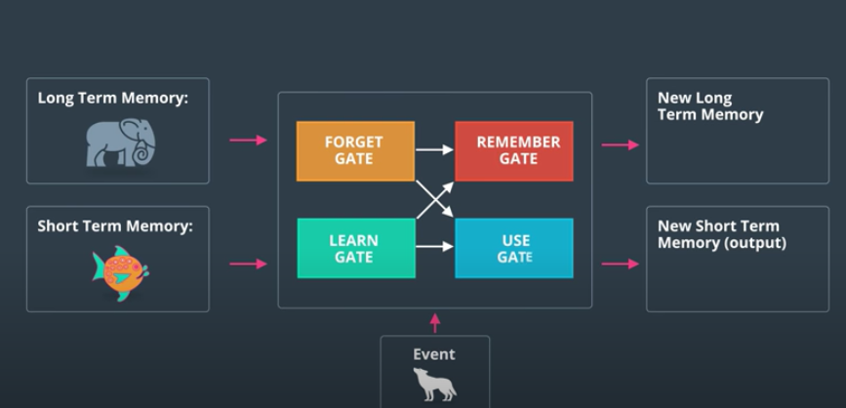
LSTM
They way LSTMs achieve this is by using gates.
They use forget gate,learn gate,remember gate and use gate.
Source: Udacity

Slide 14
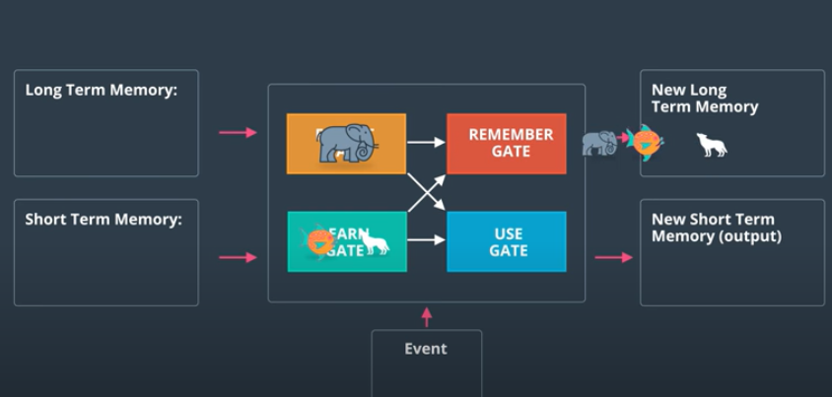
LSTM Gates
Long Term memory goes into forget gate.
Short Term memory goes in Learn Gate along with input X and it gets combined to learn a new state.
Remember gate combines all the information from learn gate and forget gate and becomes the new long term memory.
Use gate decides which information maybe immediately useful for next event.

Slide 15
LSTM
They way LSTMs achieve this is by using gates.
They use forget gate,learn gate,remember gate and use gate.
Source: Udacity

